Slide 1

Heat and Thermodynamics
Md. Anisur Rahman
Assistant Professor (Physics)
University of Asia Pacific
Dhaka, Bangladesh

Slide 2
Second law of thermodynamics
There are many ways of stating the second law of thermodynamics, but all are equivalent in the sense that each form of the second law logically implies every other form (Fermi, 1936).
The second law of thermodynamics states that the entropy of an isolated system or any cyclic process never decreases; it will either increase or remain the same. Because of this, the second law provides a definitive direction in which time must progress by saying that time may only pass in the direction of increasing entropy.

Slide 3
The second law of thermodynamics states that the entropy of any isolated system always increases.
Energy is the ability to bring about change or to do work. The Second Law of Thermodynamics states that "in all energy exchanges, if no energy enters or leaves the system, the potential energy of the state will always be less than that of the initial state." This is also commonly referred to as entropy.

Slide 4

What does the change in entropy during an explosion tell us about the direction of time in the universe?

Slide 5
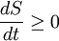
Clausius Statement: Rudolf Clausius states that "Heat generally cannot flow spontaneously from a material at a lower temperature to a material at a higher temperature"or it is impossible for a self-acting machine, unaided by an external agency, to convert heat from a colder to a warmer body.
Another formulation of the second law, the heat engine formulation, by Lord Kelvin, is:
It is impossible to convert heat completely into work.
In terms of time variation, the mathematical statement of the second law for a closed system undergoing an adiabatic transformation is:
where, S is the entropy and t is time. This statement is the best-known phrasing of the second law i.e”The entropy of the universe tends to a maximum.”

Slide 6
Application of Second Law of thermodynamics in Daily life:
The second law of thermodynamics plays the most important role in making our life easier, i.e. heat transfer in between the two mediums by conduction, convection and radiation.
The concept of heat transfer is used in wide range of devices like heat exchangers, evaporators, condensers, radiators, cookers, heaters, etc.
Jet engines
Spark-ignition engines
Fossil fueled steam power plants
All the refrigerators
Deep freezers
All types of air-conditioning systems
Heat pumps

Slide 7

The Second Law of Thermodynamics says that processes that involve the transfer or conversion of heat energy are irreversible.

Slide 8
Reversible Process and Irreversible Process
A reversible process is one which can be retraced in the opposite direction so that the working substance passes through exactly the same states in all respects as in the direct process.
The process which cannot be retracted in opposite order by reversing the controlling factors is called irreversible process. Most of the process in nature are irreversible.
Examples:
(i) A given mass of ice changes to water when a certain amount of heat is absorbed by it and the same mass of water changes to ice when the same quantity of heat is removed from it.
(ii) Evaporation is reversible as water changes to steam on absorbing heat, and steam changes to water on loosing heat.
(iii) The performance of a spring balance is an example of a reversible process.

Slide 9
Irreversible Process :examples-
The conduction of heat from a hot body to a cold body.
Production of heat by the friction
Producing of heat by the passing of current through an electrical resistance
Transfer of heat by radiation
An explosion
Inelastic deformation
Magnetization or polarization with a hysteresis
Spontaneous chemical reactions
Spontaneous mixing of matter of varying states

Slide 10
Heat-death: The 'heat-death' of the universe is when the universe has reached a state of maximum entropy. This happens when all available energy (such as from a hot source) has moved to places of less energy (such as a colder source). Once this has happened, no more work can be extracted from the universe. Since heat ceases to flow, no more work can be acquired from heat transfer. This same kind of equilibrium state will also happen with all other forms of energy (mechanical, electrical, etc.). Since no more work can be extracted from the universe at that point, it is effectively dead, especially for the purposes of humankind. The heat death of the universe will only occur if the universe will last for an infinite amount of time. The heat death will occur in 10¹⁰⁰ years (timeline from Big Bang to Heat Death), until the last proton of matter will decay into energy and dissipate.
10¹⁰⁰ years
Graphical timeline from Big Bang to Heat Death. This is the timeline of the Universe from Big Bang to Heat Death scenario. The heat death will occur in 10¹⁰⁰ years, if protons decay.

Slide 11
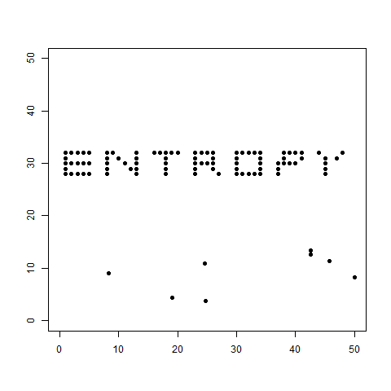
Entropy
In thermodynamics, entropy is a measure of the unavailability of a system’s energy to do work. It is a measure of the randomness of molecules in a system. Spontaneous changes tend to smooth out differences in temperature, pressure, density, and chemical potential that may exist in a system, and entropy is thus a measure of how far this smoothing-out process has progressed.

Slide 12
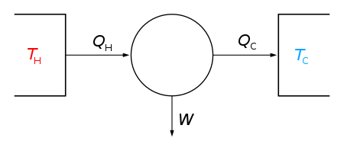
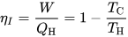
Carnot engine
The Carnot cycle is a particular thermodynamic cycle, modeled on the hypothetical Carnot heat engine, proposed by Nicolas Léonard Sadi Carnot in 1824. A thermodynamic cycle occurs when a system is taken through a series of different states, and finally returned to its initial state.
The Carnot engine is the most efficient heat engine which is theoretically possible. The efficiency depends only upon the absolute temperatures of the hot and cold heat reservoirs between which it operates.
Carnot engine diagram (modern) - where an amount of heat QH flows from a high temperature TH furnace through the fluid of the "working body" (working substance) and the remaining heat QC flows into the cold sink TC, thus forcing the working substance to do mechanical work W on the surroundings, via cycles of contractions and expansions.

Slide 13
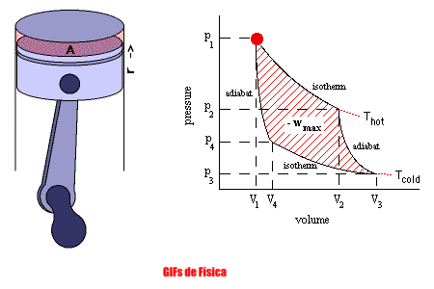
Carnot cycle
The Carnot cycle consists of the following four processes:
A reversible isothermal gas expansion process.
A reversible adiabatic gas expansion process.
A reversible isothermal gas compression process.
A reversible adiabatic gas compression process.

Slide 14
The Third Law of Thermodynamics
The third law of thermodynamics states that the entropy of a system approaches a constant value as the temperature approaches absolute zero. The entropy of a system at absolute zero is typically zero, and in all cases is determined only by the number of different ground states it has. Specifically, the entropy of a pure crystalline substance (perfect order) at absolute zero temperature is zero. This statement holds true if the perfect crystal has only one state with minimum energy.
The third law of thermodynamics is sometimes stated as follows:
The entropy of a perfect crystal of any pure substance approaches zero as the temperature approaches absolute zero.
At zero temperature the system must be in a state with the minimum thermal energy. This statement holds true if the perfect crystal has only one state with minimum energy.

Slide 15


